Slide 1
Velocity Scripting 101

Slide 2
Agenda
What is Velocity
Velocity in Polarion
Basics
Context
Rendering API
Open Java API
Widgets
Q&A

Slide 3
The Apache Velocity Project
Template & Scripting Engine
Dynamic content
Basic control statements
Java methods
Include files
Macros

Slide 4
Velocity in Polarion
Subset of Java capabilities
Compile vs reload
Classic Wiki Pages
Write
xWiki, LiveDoc
Rich Pages
Read Only
Widgets, Page Script
Script Block/Inline Script, Widget Parameters
Velocity Widget Development

Slide 5

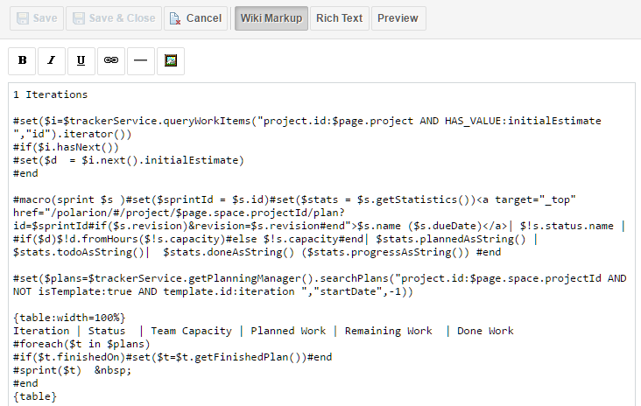
Velocity in Polarion xWiki

Slide 6
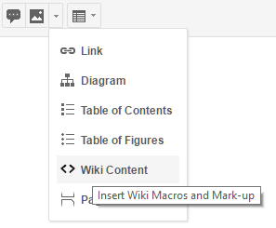
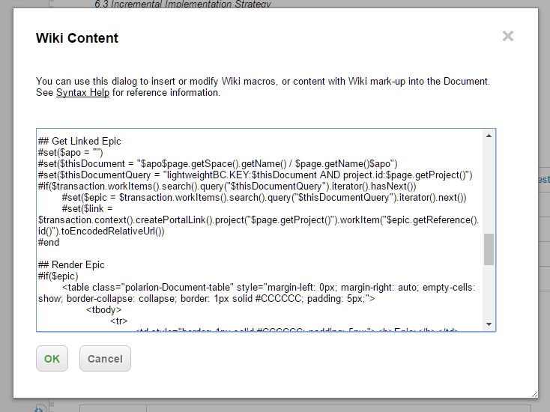
Velocity in Polarion LiveDoc

Slide 7

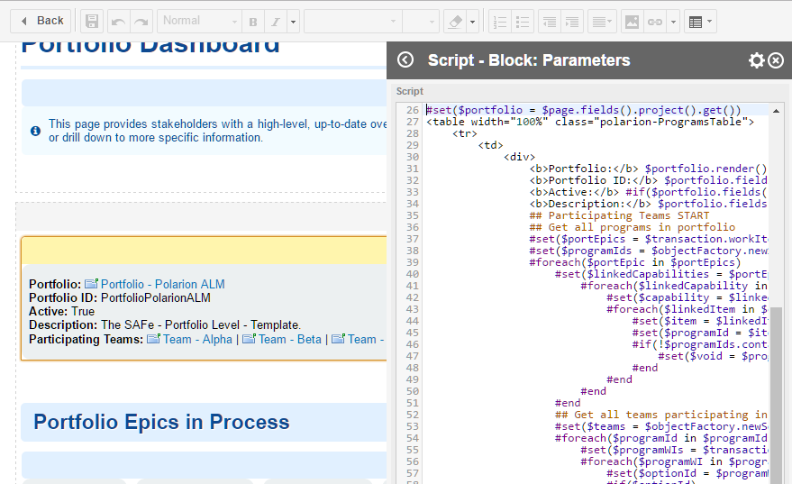
Velocity in Polarion Script Block

Slide 8

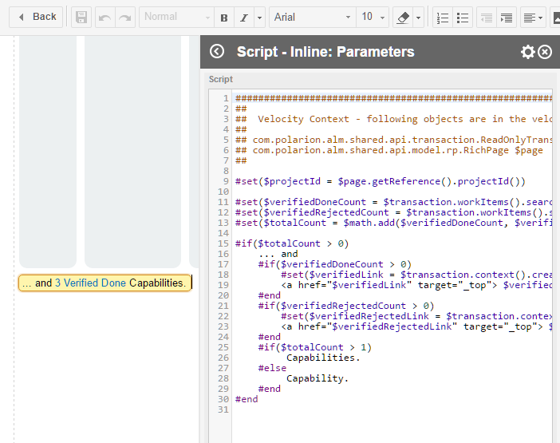
Velocity in Polarion Inline Script

Slide 9
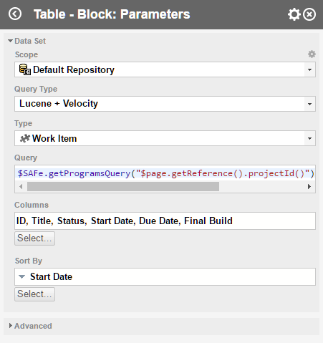
Velocity in Polarion Widget Parameters

Slide 10
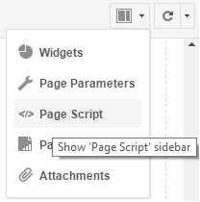
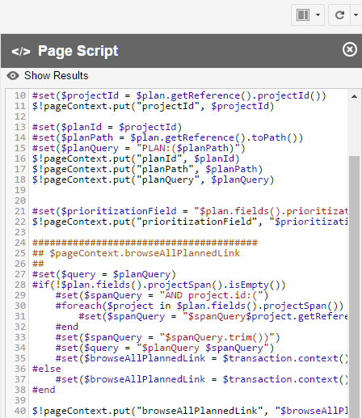
Velocity in Polarion Page Script

Slide 11








Basics - Variables
Weakly typed

Slide 12
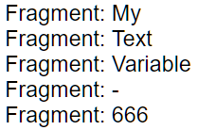



Basics – Loops
Iterate over a collection of values
#foreach($value in $values) do_something
#end

Slide 13
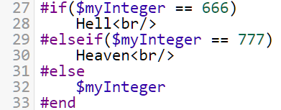
Basics - Conditions
Do or skip a block of code
#if(condition1) do_sth
#elseif(condition2) do_sth_other
#else do_sth_else
#end

Slide 14



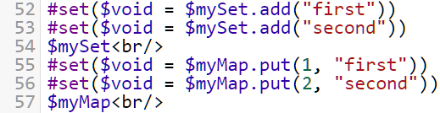

Basics – Array, Set, Map
Holds more values in one variable
Array built-in Velocity
Set & Map extended by $objectFactory
Rich Pages only

Slide 15
Basic - Example
Create a set with values “a”, “b”, “c” and “abc”
Use the set to render its values as following:
Formula: a * b * c = abc
Notes:
#set($formula = $objectFactory.newSet())
#set($void = $formula.add("a"))
#set($void = $formula.add("b"))
#set($void = $formula.add("c"))
#set($void = $formula.add("abc"))
<i>Formula:</i>
#foreach($value in $formula)
#if($velocityCount != 4)
$value *
#else
= <b>$value</b>
#end
#end

Slide 16
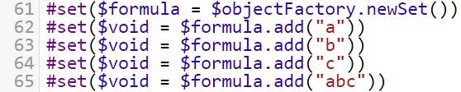
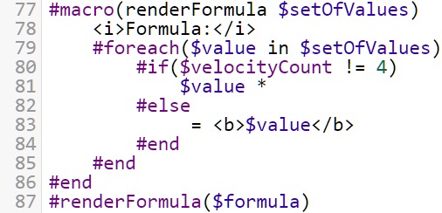
Basics - Macros
Reuse of code with parameters
#macro(macroName $param1 $param2 …) code #end
#macroName(“text” 10 …)

Slide 17

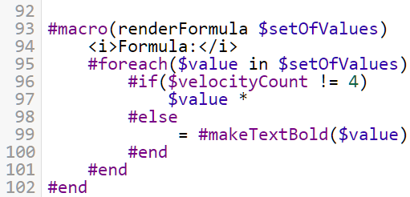
Basic – Macro Chaining
Possible to call macro from macro
Even the same macro from itself – recursion

Slide 18
Context
Velocity is extended by additional services
Widget SDK – Part 8: Velocity Context Reference
Available everywhere
Polarion API
Open Java API (Old API)
$trackerService | $projectService | $securityService | $platformService | $testManagementService
Rendering API (New API)
$transaction
Polarion Objects
$me | $localization | $page/$plan/$testRun/$document
Available in Rich Pages
$objectFactory | $pageContext | $factory
$parameters | $pageParameters | $urlParameters | $scriptedPageParameters
$widgetContext (not in Page Script) | $renderingContext (in Page Script)
Tools: $date | $math | $sorter | $number …

Slide 19
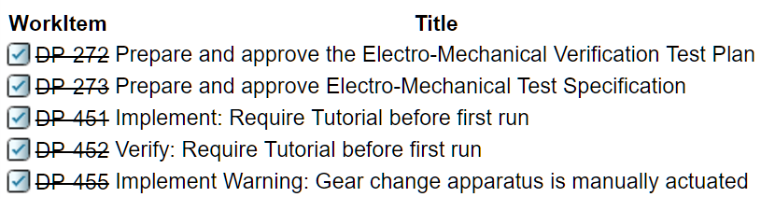
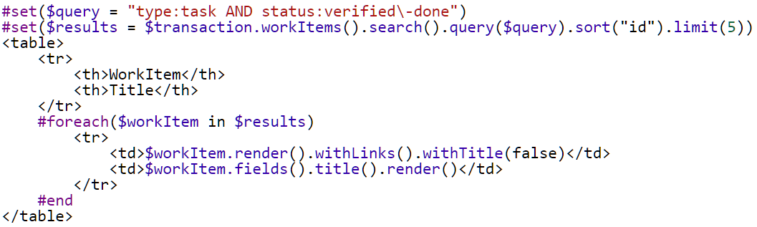
Rendering API
$transaction - ReadOnlyTransaction
Documentation
Querying and rendering
Method chaining

Slide 20
Open Java API
$trackerService (iTrackerService) | $projectService | $securityService | $platformService | $testManagementService
Documentation
Baselines, Work Records in days/hours, Project Groups, User Roles…

